Slide 1
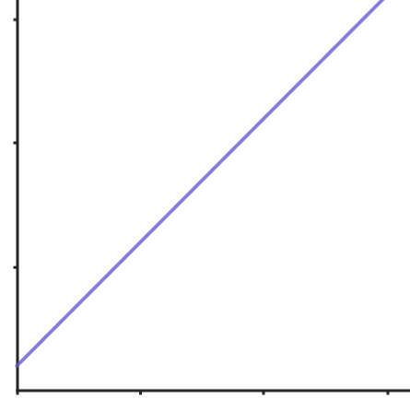
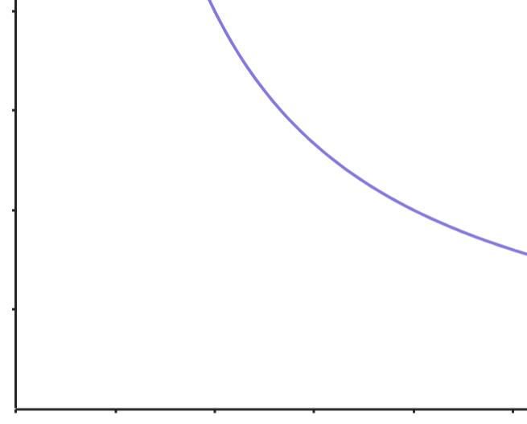
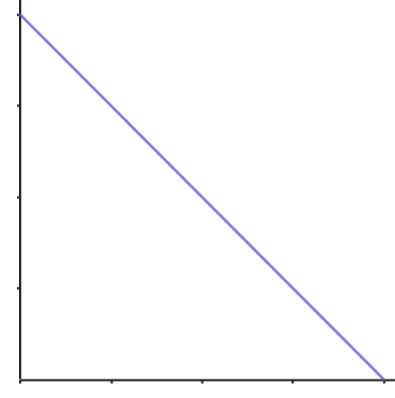
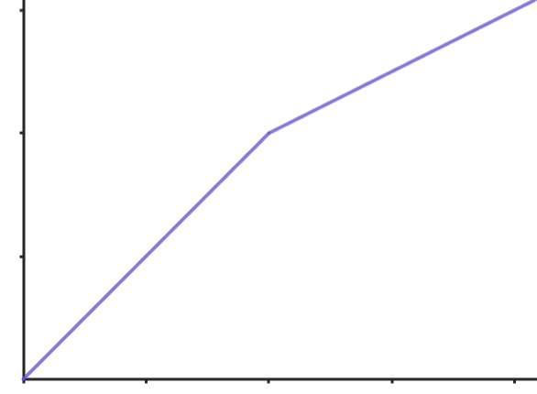
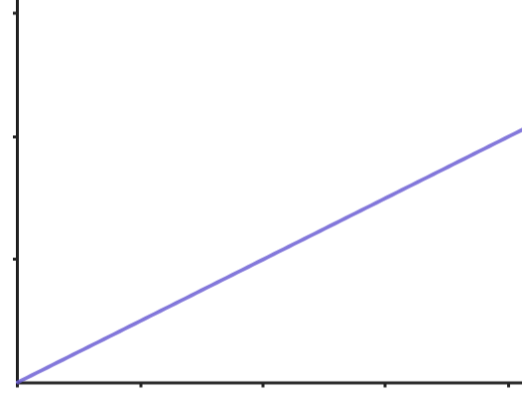
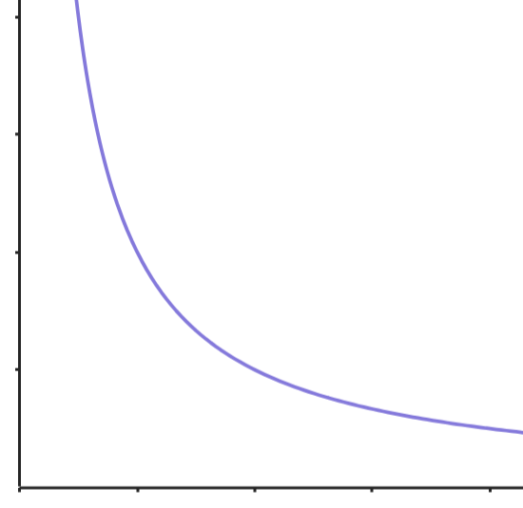
Inverse proportion in context
Task A: Graphs of inverse proportion
Label each of the graphs as direct proportion, inverse proportion or neither.
a)
b)
c)
neither
inverse proportion
neither
d)
e)
f)
neither
direct proportion
inverse proportion
2) Decide if the following situations are directly or inversely proportional:
The number of taps and the time taken to fill a bath. Inverse
The number of Euros exchanged and the number of pounds. Direct
The number of boxes of tiles bought and the cost. Direct
The number of days to dig a hole and the number of days it takes. Inverse
The time taken to get to Edinburgh and the speed of the car. Inverse

Slide 2
Inverse proportion in context
Task B: Using inverse proportion to find missing values
The following tables show variables A & B which are inversely proportional. Find the missing value.
a)
b)
c)
A | B
6 | 20
12 | 10
A | B
3 | 65
15 | 13
A | B
16 | 24
2 | 192
d)
e)
f)
A | B
20 | 16
5 | 64
A | B
12 | 8.75
5 | 21
A | B
27 | 24
8 | 81
2) Use a ratio table to answer the following:
It takes 4 people 2 days to paint a house. How long will it 8 people? 1 day
It takes 10 factory workers 4 hours to pack a lorry full of boxes. 2 people are on holiday. How long will it take to fill the lorry now? 5 hours
It takes 3 days to fill a pond if 5 taps are used. How long will it take if 4 taps are used. Give your answer in hours and minutes. 3 hours 45 minutes
4 machines work all day every day. The 7y make 1 million items in 9 days. The company buys 1 new machine. How long will it take to make 1 million items now? Give your answer in days and hours. days 12 mins
Mathematics in Education and Industry.
v2.3

